Slide 1

ONLINE QUIZ SYSTEM
Submitted by :-
AYUSHI KUMARI (Roll pat no. – 40117)
KAAJAL KAUSHAL (Roll pat no. – 40123)
MAHI (Roll pat no. – 40125)
MOHNI KUMARI (Roll pat no. – 40127)

Slide 2
PROJECT ON
ONLINE QUIZ SYSTEM FOR BCA DEPARTMENT OF MAGADH MAHILA COLLEGE
IN PARTIAL FULFILMENT OF THE REQUIREMENT FOR THE DEGREE OF BACHELOR OF COMPUTER APPLICATIONS
SESSION : 2018 – 2021
UNDER THE GUIDANCE OF
MS. SABITRI SHARMA

Slide 3

Table of contents
ABOUT THE INSTITUTE
ABOUT PROJECT
OBJECTIVES
TOOLS AND PLATFORMS
FEASIBILITY ANALYSIS
DATABASE DESIGN
ENTITY RELATIONSHIP DIAGRAM
DATA FLOW DIAGRAM
RUNTIME WINDOWS
LIMITATIONS OF PROJECT
CONCLUSION
REFERNCES

Slide 4
ABOUT THE INSTITUTE
Magadh Mahila College, the oldest premier institute for women in Bihar was established in 1946. It is a multi faculty college, began as a Government College and today holds the pride of place as a constituent unit of Patna University, teaching a vastly diverse number of the holiest river in India, it stands tall in its achievements in providing quality education in an exclusive campus for women, providing myriad facilities. The college is permanently affiliated under section 12 B of U.G.C act since 1952. It has been reaccredited with “B+” grade by the NAAC.

Slide 5

Online Quiz System is designed with the purpose of allowing the students to take quiz / test and download their certificates. It is a Multiple Choice Questions (MCQ) based system. This site is an attempt to remove the existing flaws in the manual system of conducting exams. Students are provided the flexibility to choose among different types of programming language quizzes according to their interest.
There are two interfaces of login: Teacher login and Student login.
Teacher has authority to make questions give multiple choice options and provide answers. Students are responsible for taking quizzes. They can use this quiz system for learning different sections while playing different quizzes.
ABOUT PROJECT

Slide 6
OBJECTIVES
The main objective of this system is to make conducting quizzes/tests easier and time saving.
Students / participants can login through any device with their login id and password and can take their test.
Faculties can make questions and give multiple choice options.
This system can save a lot of time as it avoids direct contact between faculty and student.
Physical appearance is not necessary.

Slide 7
TOOLS AND PLATFORM
Hardware
Software
4 GB Ram
8th Gen Intel Core i3- 5005U, 2.00 GHz
Hard disk 1 TB
Operating System: Windows 10
Front End: HTML, CSS, JavaScript
Back End : Java
Database: MySQL

Slide 8
FEASIBILITY ANALYSIS
Feasibility study is a high level version of the entire system analysis and design process.
The purpose of feasibility study is not to solve the problem but to determine if the problem is worth solving.
It is conducted to select the best system that meets performance requirements.
A system’s required the identification of specific system objectives, and a description of outputs defines performance.
Three key considerations are involved in the feasibility analysis.
Economic Feasibility
Technical Feasibility
Operational Feasibility

Slide 9
ECONOMIC FEASIBILITY
Economic analysis is the most frequently used method for evaluating the effectiveness of the proposed system. This is an ongoing effort that improves in accuracy at each phase of the system life cycle.
As the necessary software and hardware is available in the organization, the initial investment for the proposed system is NIL. The proposed system minimizes the time and effort right for quiz.
The faculty sitting at his desk can make questions without directly meeting the student.
Thus, the proposed system is economically feasible.

Slide 10
TECHNICAL FEASIBILITY
It centers around the existing computer system (hardware, software, etc.) and to what extent it can support the proposed system. The necessary hardware and software tools are available in the organization and the software recommended supports the system objectives.
Thus it is technically feasible to design and develop the proposed system.

Slide 11
OPERATIONAL FEASIBILITY
People are inherently resistant to change, and computers have been known to facilitate change. An estimate should be made of how strong a reaction the user is likely to have towards the development of a new system.
As the proposed system is a user-friendly package with all the visual aids, the effort that goes into educating and training the user staff is almost negligible. Therefore, resistance to the proposed system is nil.
Based on the above analysis, the recommended system is feasible.

Slide 12
DATABASE DESIGN
In our project “ONLINE QUIZ SYSTEM”, we used MySQL server for database design. In our project we used following database having tables for data storage:
Name of the database : oqs_database
Tables in the database :
studdetails
facdetails
javaqb
pythonqb
cppqb
oracleqb

Slide 13
TABLES The lists of fields which are used in the database are as follows:
studdetails
Sl. No. | Field Name | Field Type | Field Size
1 | username | varchar | 100
2 | email | varchar | 30
3 | password | varchar | 8
4 | mob_no | int | 10
5 | date_of_birth | date | -
6 | education | varchar | 100

Slide 14
facdetails
Sl. No. | Field Name | Field Type | Field Size
1 | username | varchar | 100
2 | email | varchar | 30
3 | password | varchar | 8
4 | mob_no | int | 10
5 | date_of_birth | date | -
6 | qualification | varchar | 100

Slide 15
Sl. No. | Field Name | Field Type | Field Size
1 | ques | varchar | 200
2 | op1 | varchar | 100
3 | op2 | varchar | 100
4 | op3 | varchar | 100
5 | op4 | varchar | 100
6 | ans | varchar | 100
javaqb
Sl. No. | Field Name | Field Type | Field Size
1 | ques | varchar | 200
2 | op1 | varchar | 100
3 | op2 | varchar | 100
4 | op3 | varchar | 100
5 | op4 | varchar | 100
6 | ans | varchar | 100
pythonqb

Slide 16
Sl. No. | Field Name | Field Type | Field Size
1 | ques | varchar | 200
2 | op1 | varchar | 100
3 | op2 | varchar | 100
4 | op3 | varchar | 100
5 | op4 | varchar | 100
6 | ans | varchar | 100
cppqb
Sl. No. | Field Name | Field Type | Field Size
1 | ques | varchar | 200
2 | op1 | varchar | 100
3 | op2 | varchar | 100
4 | op3 | varchar | 100
5 | op4 | varchar | 100
6 | ans | varchar | 100
oracleqb

Slide 17
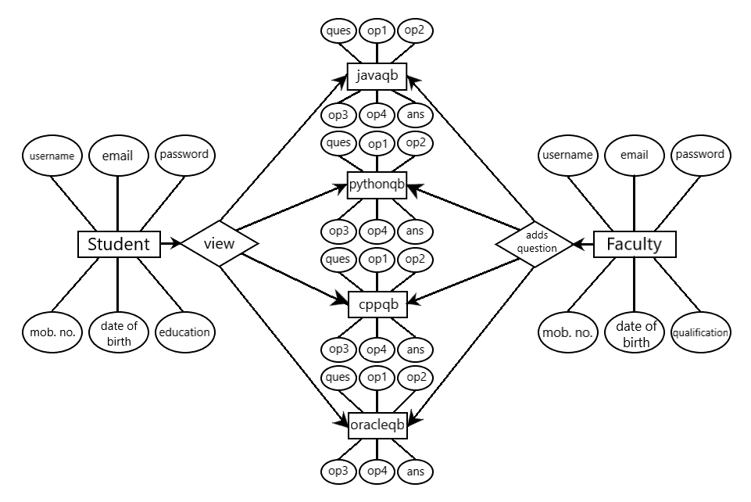
ENTITY RELATIONSHIP DIAGRAM

Slide 18
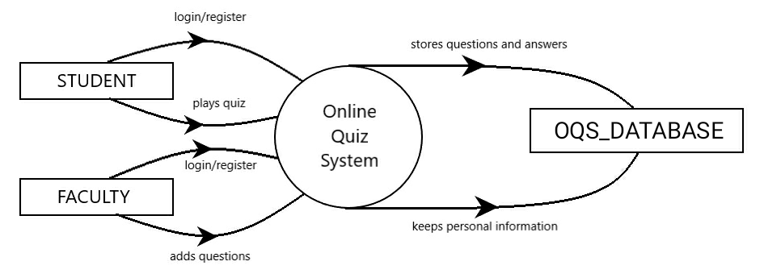
CONTEXT ANALYSIS DIAGRAM

Slide 19
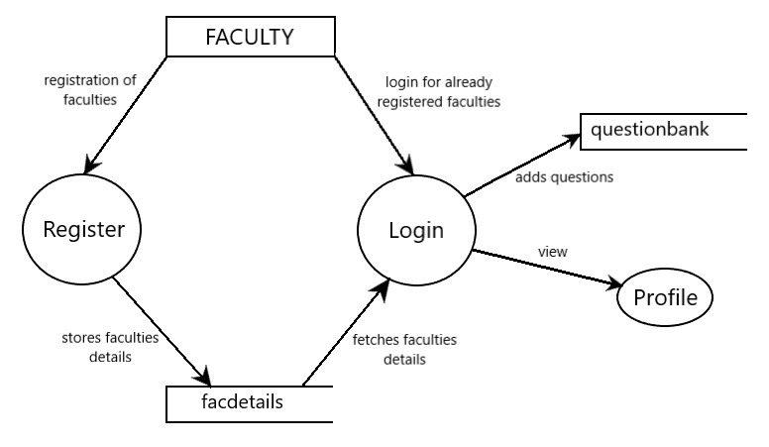
DATA FLOW DIAGRAM
LEVEL 1 DFD FOR FACULTY

Slide 20
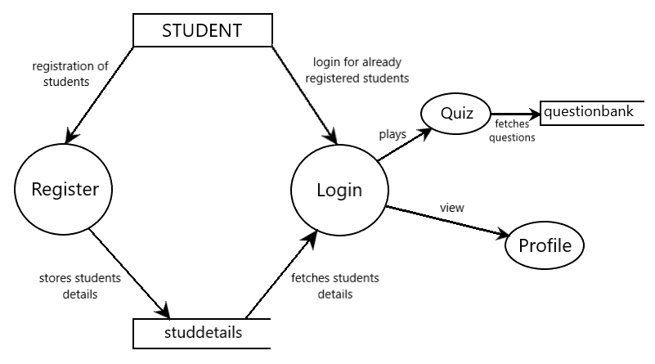
DATA FLOW DIAGRAM
LEVEL 1 DFD FOR STUDENT

Slide 21
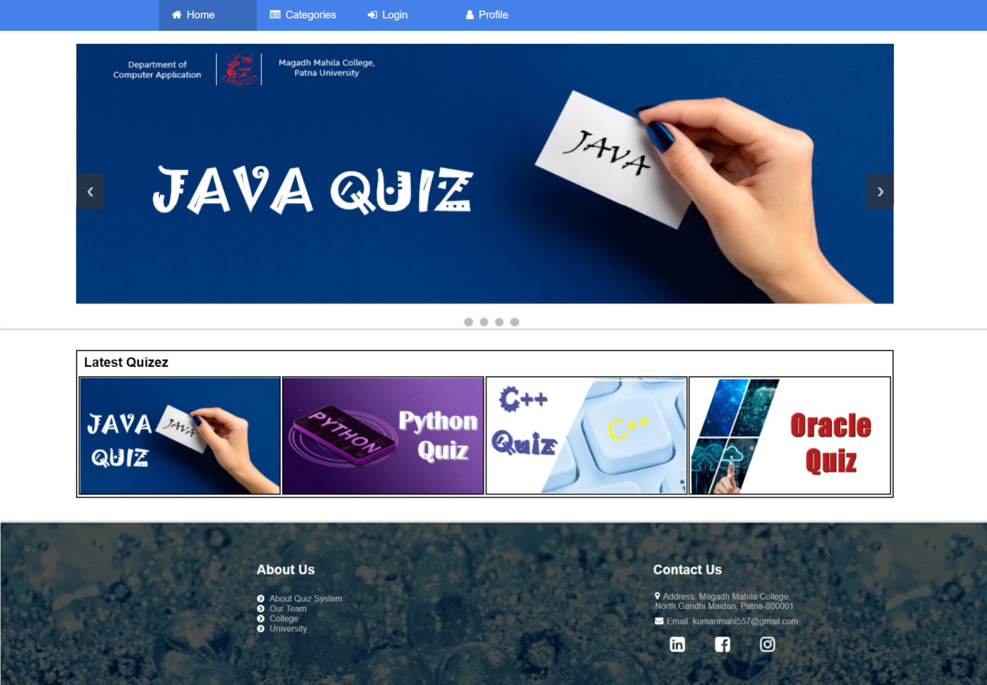
RUNTIME WINDOWS
HOME

Slide 22
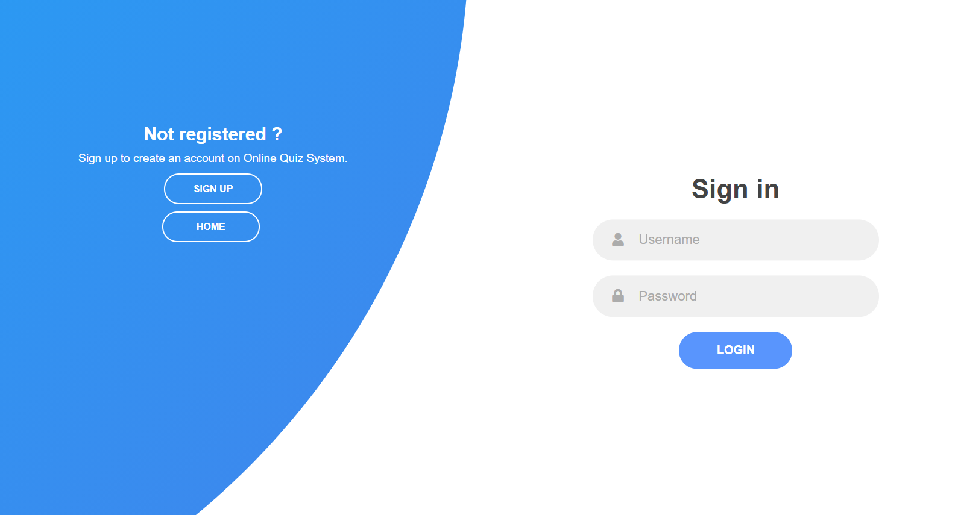
LOGIN

Slide 23
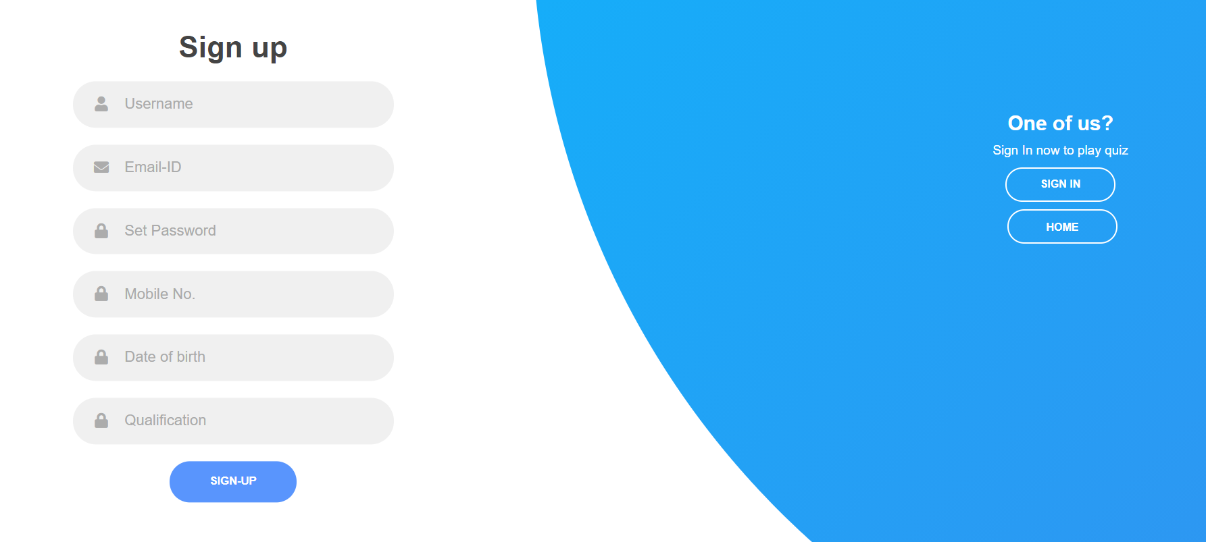
TEACHER’S REGISTRATION

Slide 24
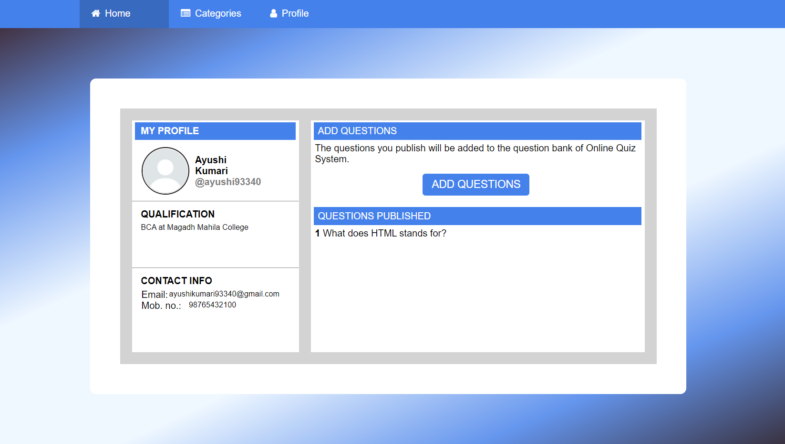
TEACHER’S PROFILE

Slide 25
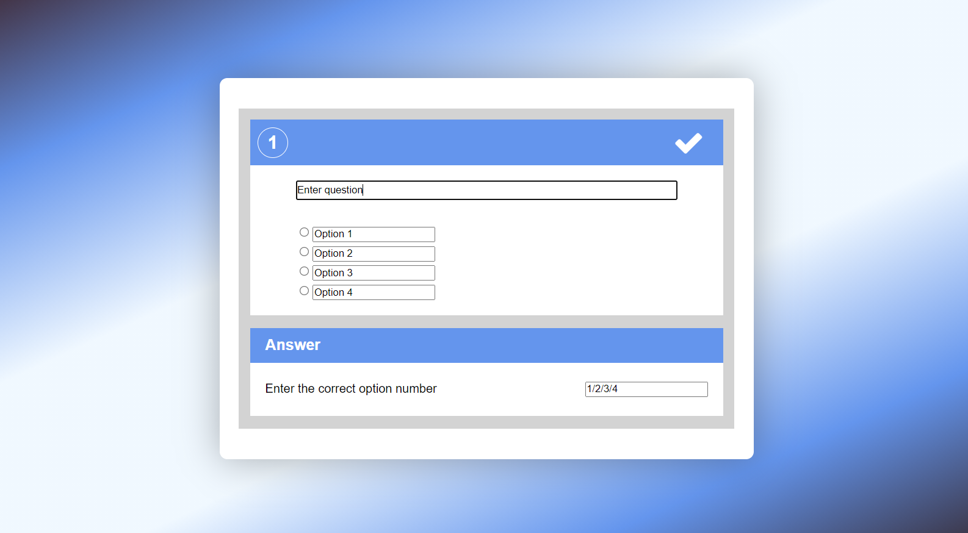
ADD QUESTION

Slide 26
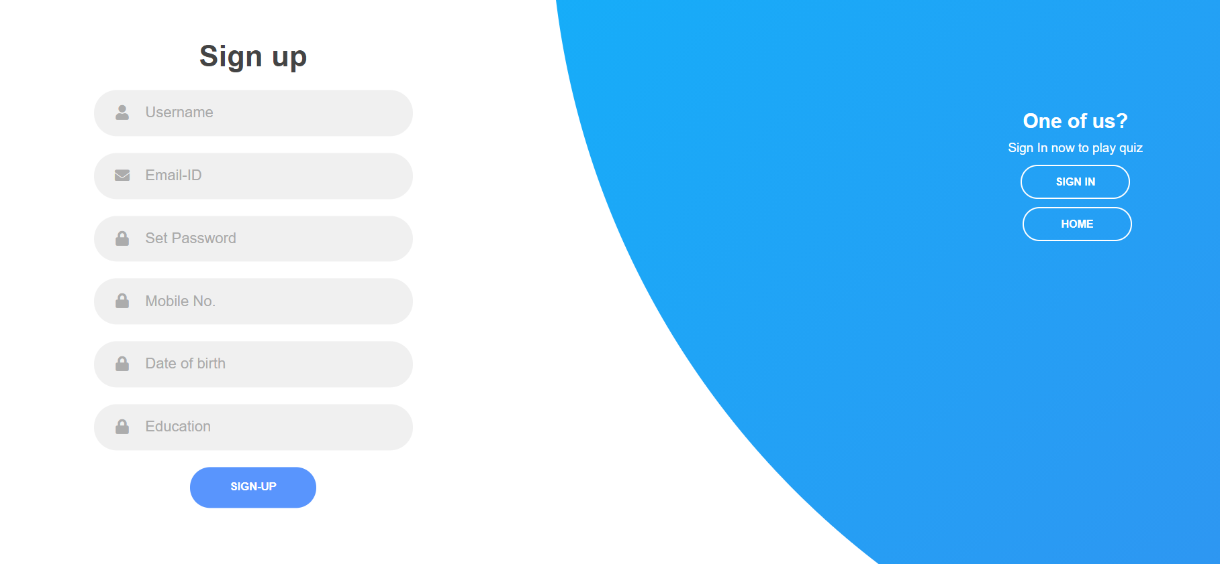
STUDENT’S REGISTRATION

Slide 27
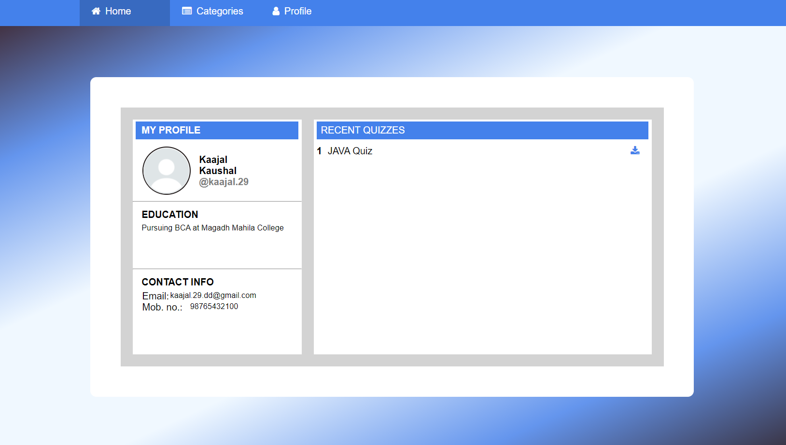
STUDENT’S PROFILE

Slide 28
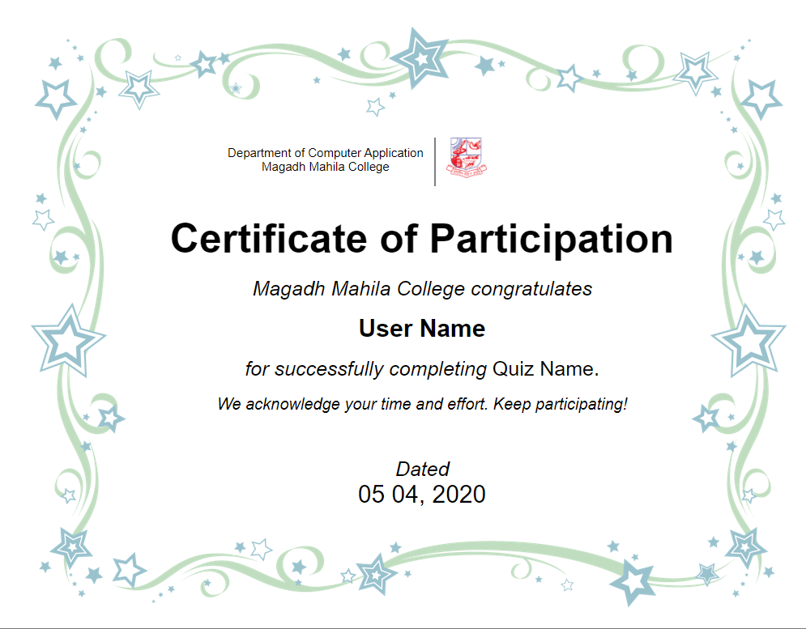
CERTIFICATE OF PARTICIPATION

Slide 29
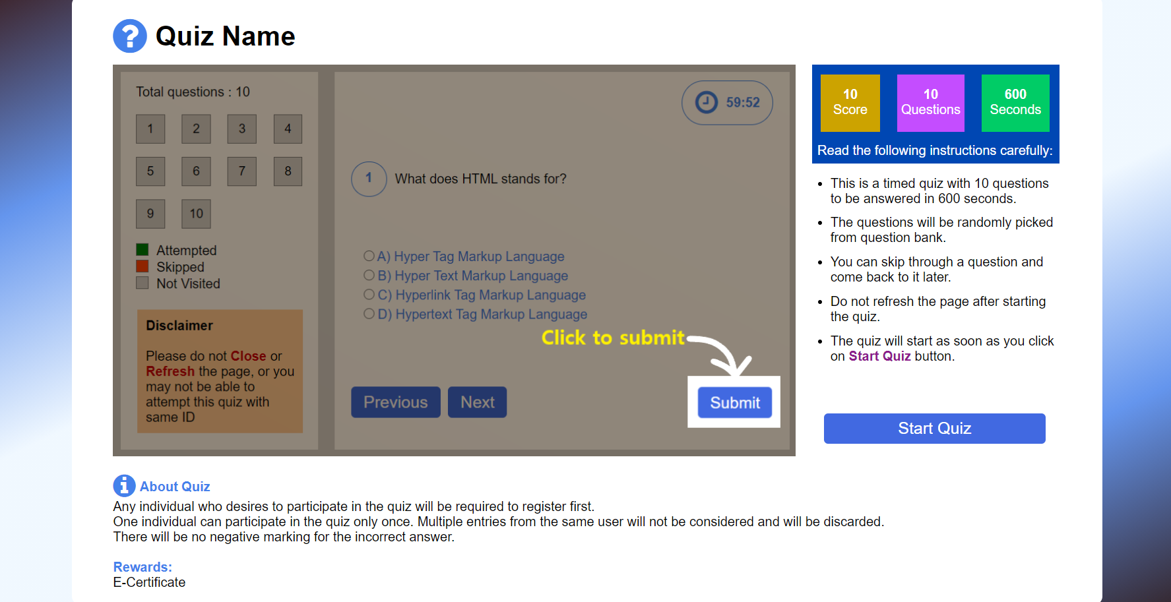
QUIZ INFORMATION

Slide 30
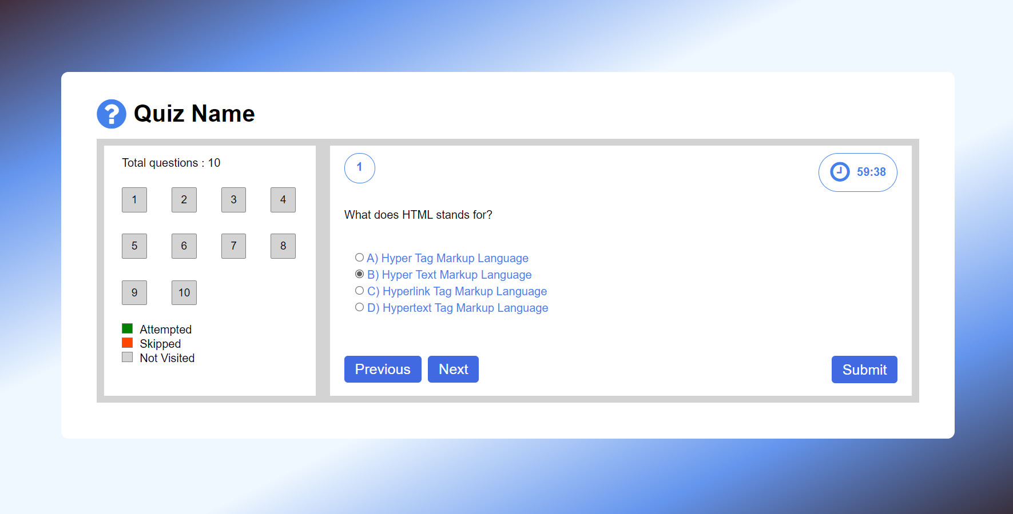
PLAY QUIZ

Slide 31
LIMITATIONS OF PROJECT
Project is department based, so categories available are limited.
Profile details are not updatable.

Slide 32
CONCLUSION
By creating this Online Quiz System for Department of Computer Applications of Magadh Mahila College, it is aimed to make the process of take quiz much easier and computerized. The main objective of this system is to make it easier and time saving. We got practical experience of working on this project which has given us a chance to put into the practice of the concepts that we have only been studied in theories. During this project, we accept a chance to sharpen our skills on technical, analysis or interpersonal skills. This project is finished according to software development life cycle (SDLC) approach and through this approach we are able to learn more on practically how to work on a project whether individually or in a group.

Slide 33
REFERENCES
w3schools.com
geeksforgeeks.org
tutorialspoint.com
studentstutorial.com

Slide 34
Thank You

